Slide 1
Project : News Search and Sentiment Analysis Tool
By- Pradeep Kumar Chauhan

Slide 2
Overview
This project is a web-based application that enables users to search for recent news articles related to a specific topic and analyze the sentiment of those articles. It utilizes APIs and AI-driven natural language processing to deliver insightful feedback on news content.

Slide 3
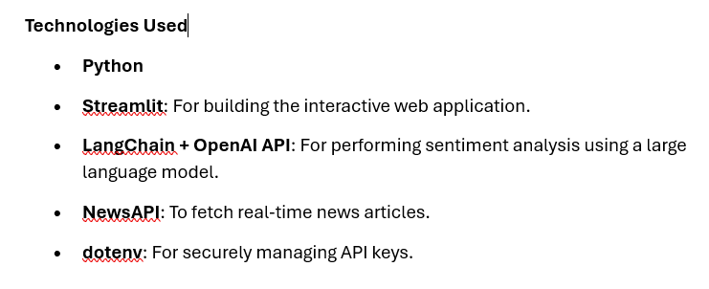
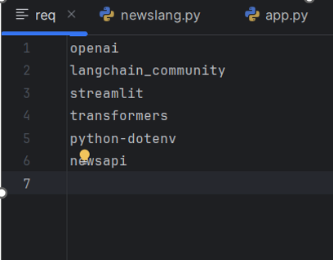
Requirements (req.txt)

Slide 4
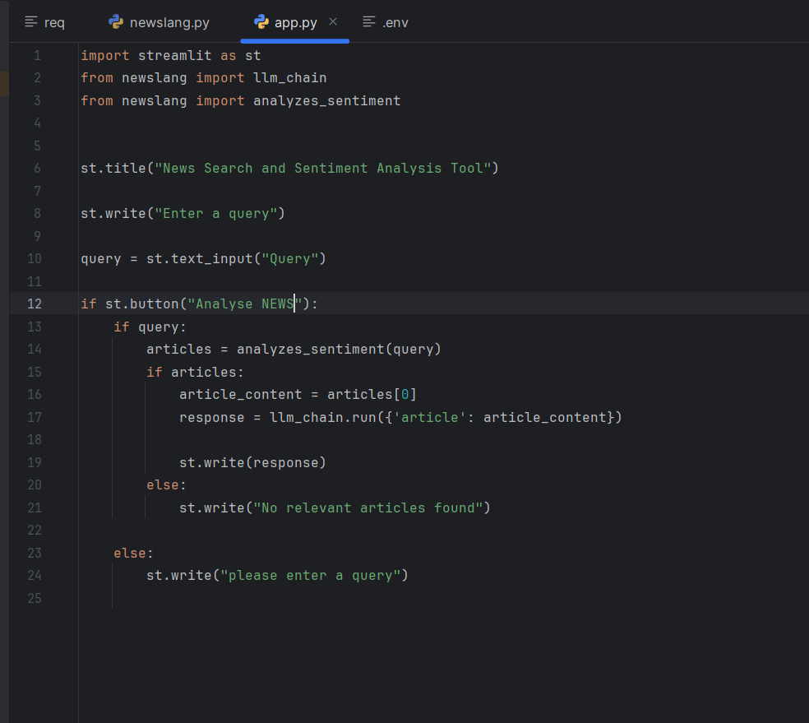
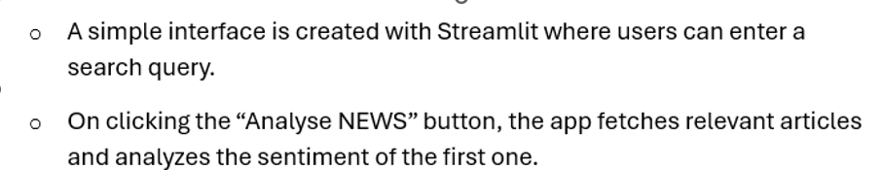
User Interface (app.py):

Slide 5
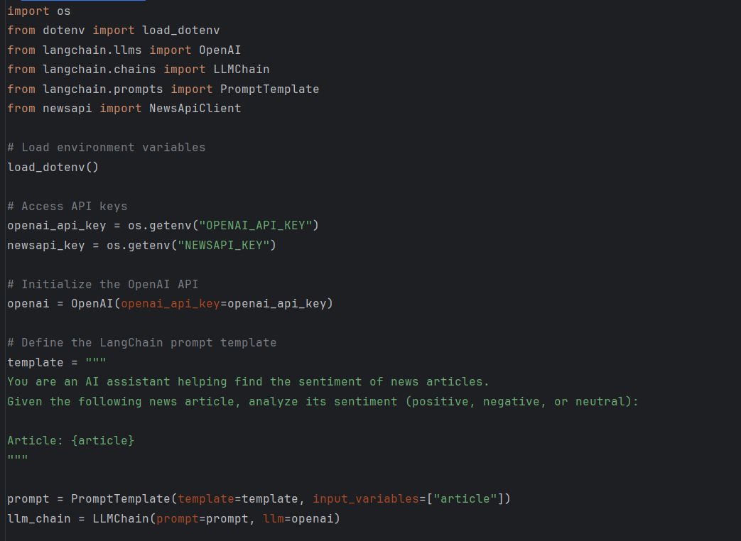
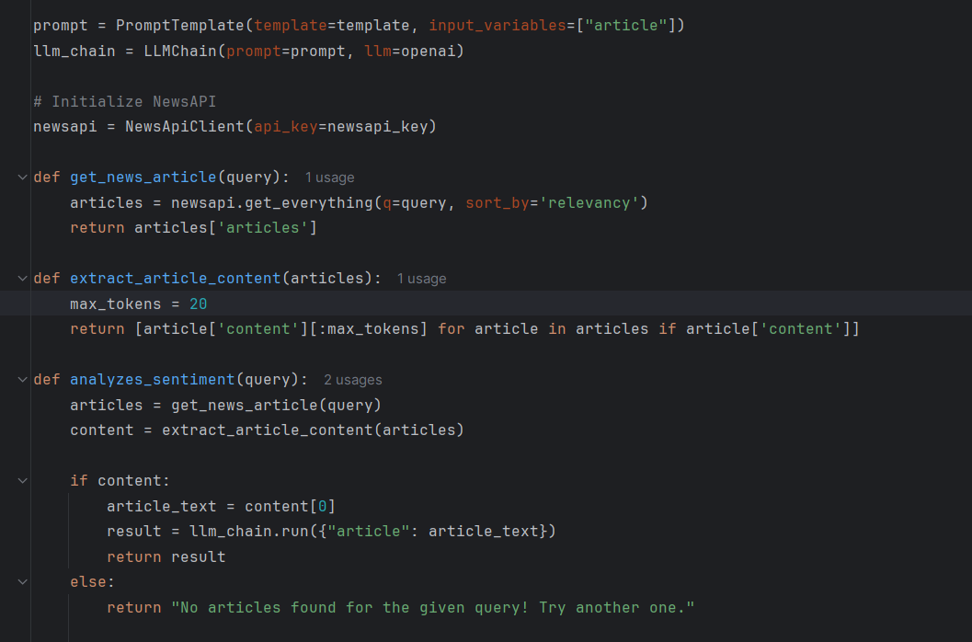
Article Retrieval and Analysis

Slide 6

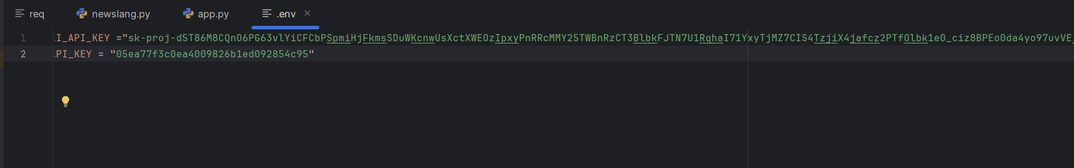
Security (.env):

Slide 7
Key Features
Real-time news fetching.
Automated sentiment analysis powered by OpenAI.
Simple and user-friendly interface.
Clean modular code using best practices like environment variable management and separation of concerns.

Slide 8
Limitations & Suggestions
Currently analyzes only the first article returned by the NewsAPI.
Only a snippet (first 20 tokens) of the article content is used, which may limit analysis quality.
Could be improved by:
Processing more articles for a broader sentiment picture.
Using more of the article content (while managing token limits).

Slide 9
Thank you

